Slide 1
Medicare, Part E
Daniel Tang, MFS

Slide 2
What Drives Medicare Costs?
As of 2010:
-48 million Americans covered
-40 million >65
-8 million <65
-Covered 47.2% of inpatient hospital costs in US
As of 2013:
-3% of GDP

Slide 3
Pipeline

Slide 4
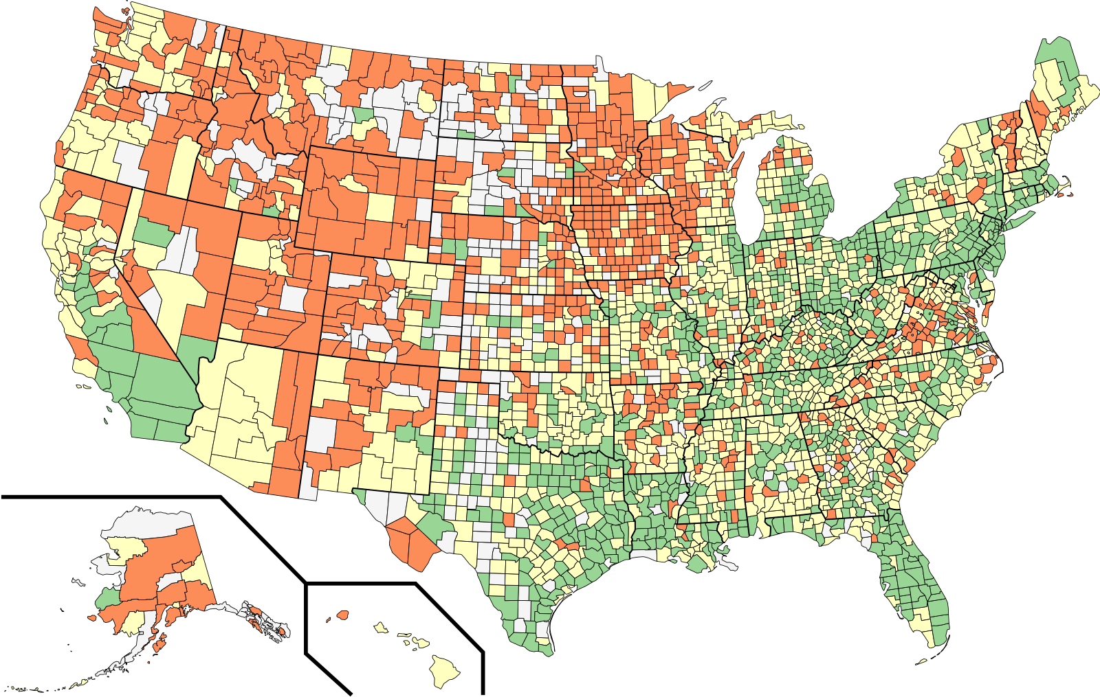
Counties Clustered On Disease Profile
Cluster 1 | Cluster 2 | Cluster 3
Cook (Chicago) | King | Albany
Dallas | Denver | Chester
Los Angeles | Salt Lake | Kittitas
Orleans Parish | San Fran. | Santa Cruz
Travis (Austin) | Santa Clara | Teton

Slide 5
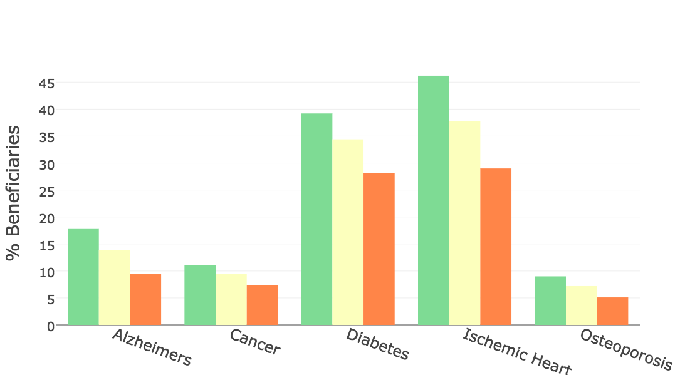
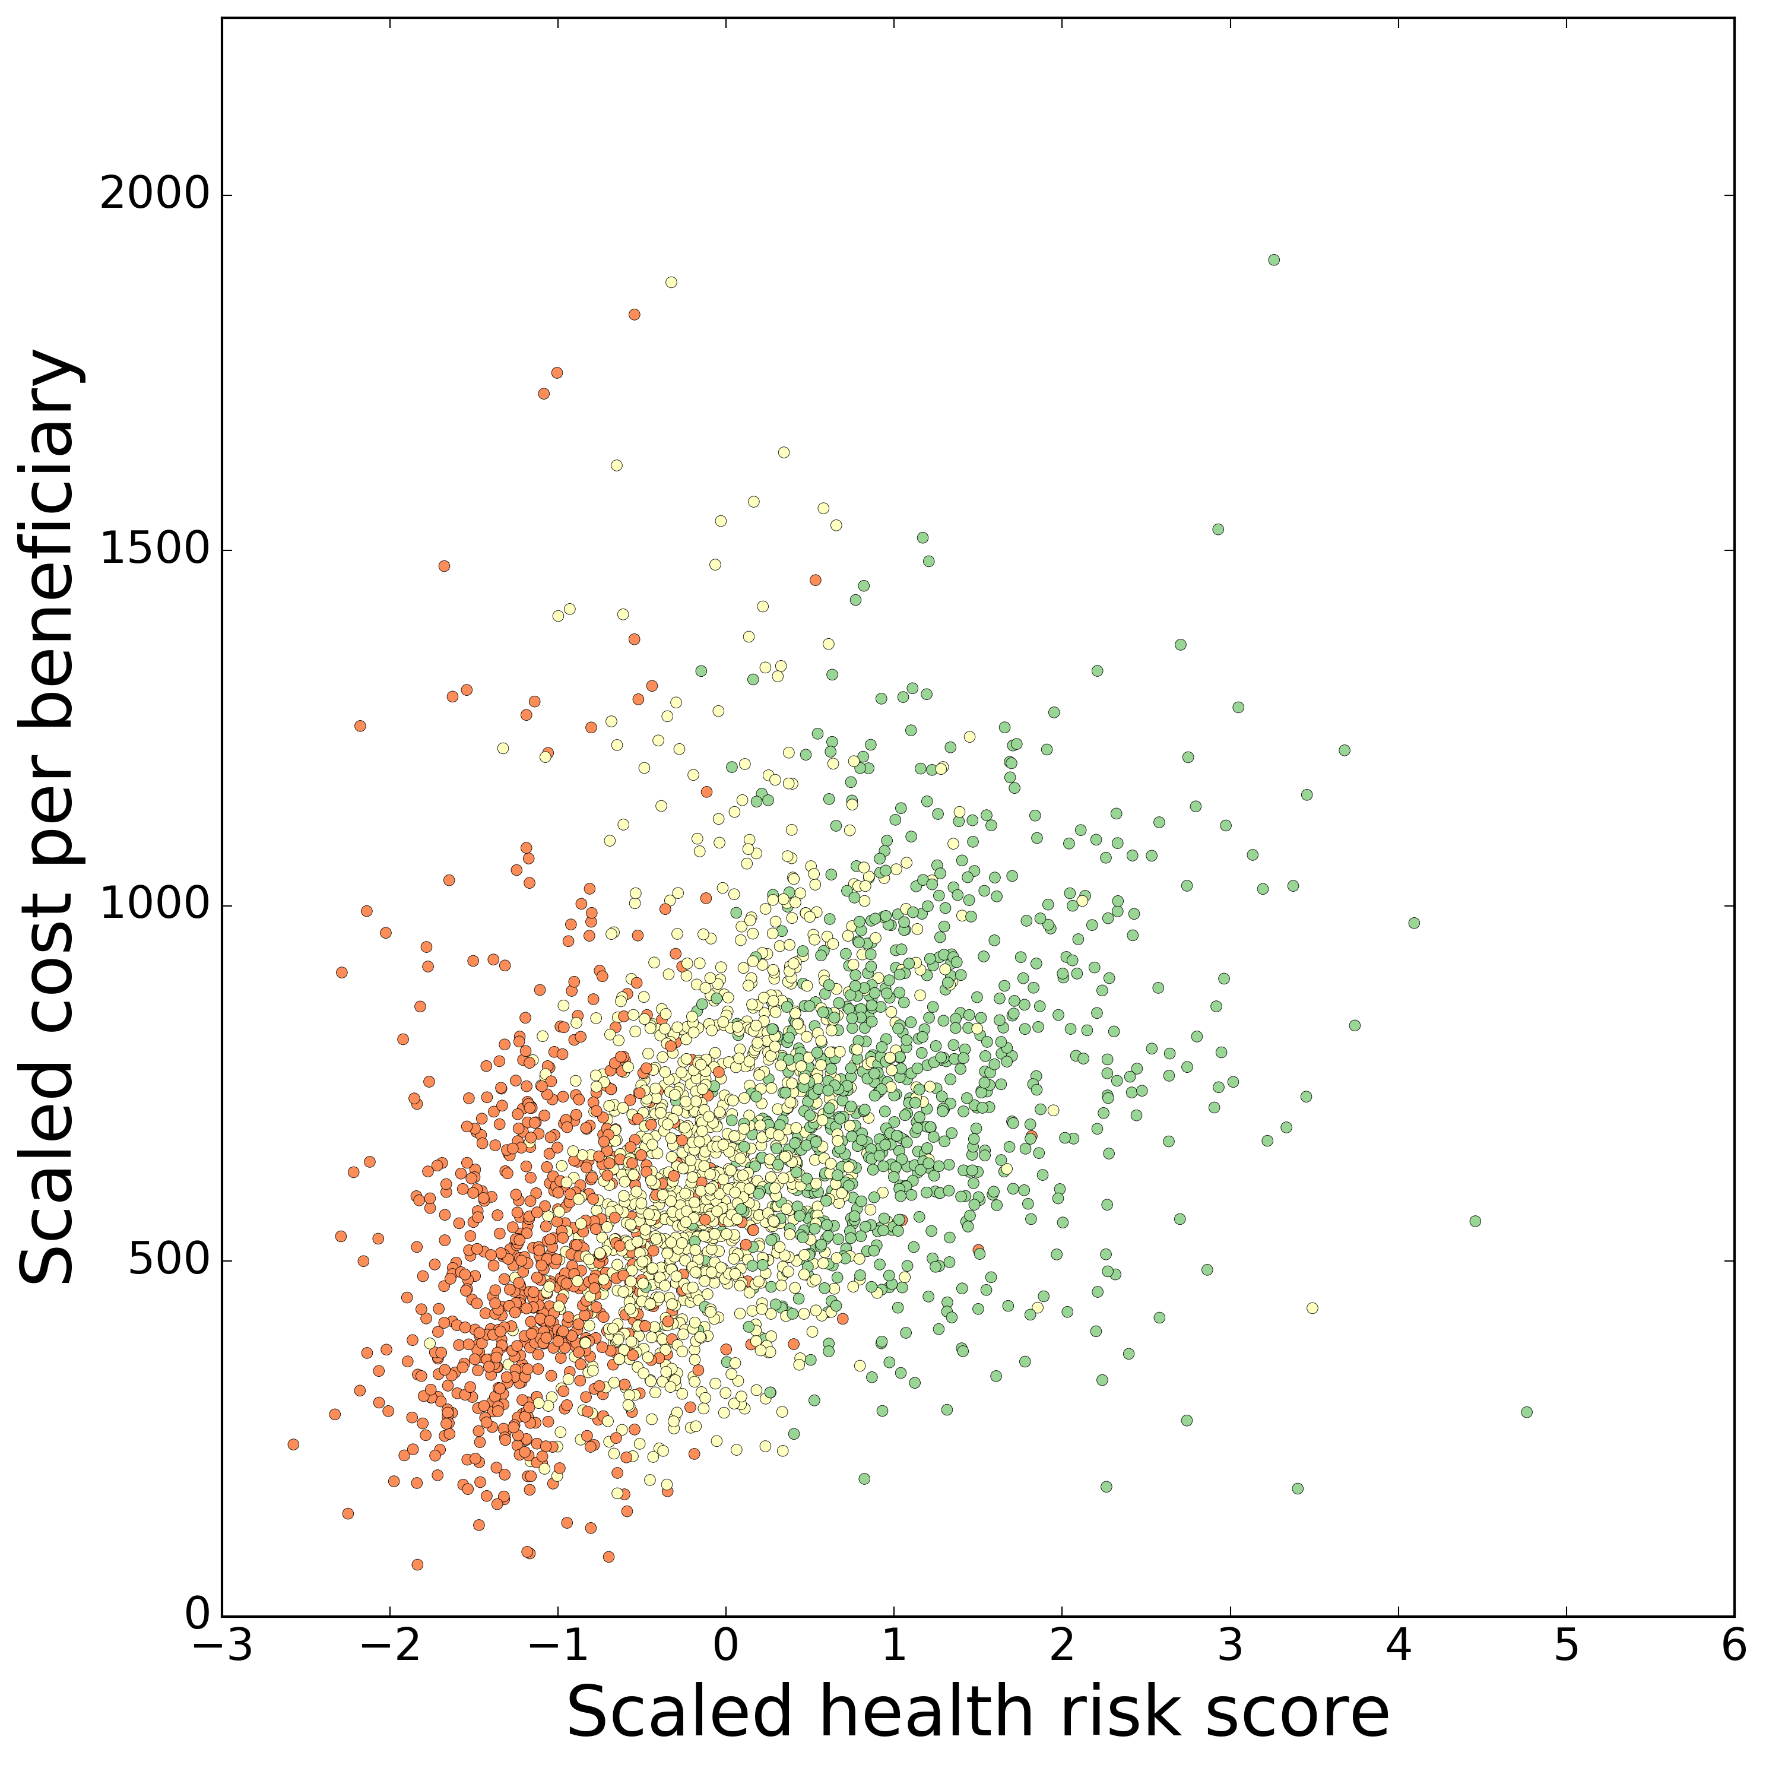
Disease Profiles and Charges by Clusters
Notes:
Add in model that predicts costs on disease?
Left side is examples of disease profiles
Right side shows total costs by clusters
Transition, so if you’re Medicare, I’ve told you that costs are dependent on the amount of disease in the county. Not too much you can do about that.
What about differences in how diseases are being treated within one discipline?

Slide 6
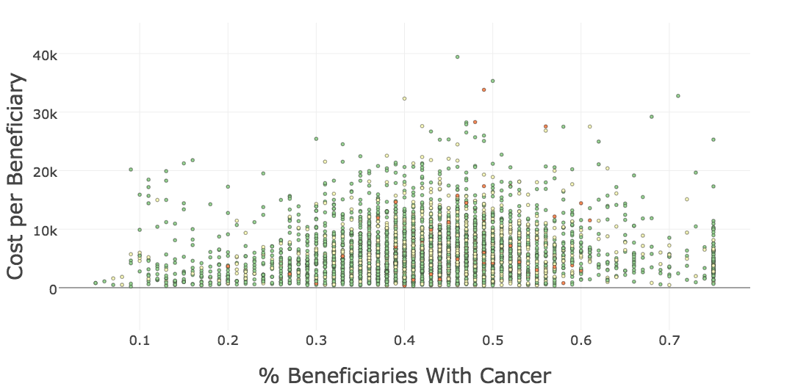
Oncologists Costs Not Dependent on Percent of Patients with Disease

Slide 7
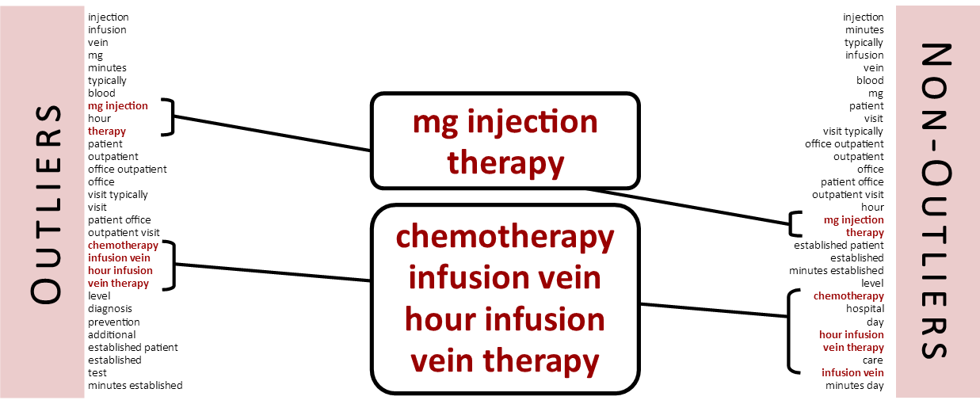
Comparison of Services Performed via TFIDF

Slide 8
Future Work
Build a model to predict costs of oncologists
Generalize model to other specialties

Slide 9
Thank you
Daniel Tang, MFS
in/danielttang
d-tang/medicare-project
tang.daniel@gmail.com

Slide 10
Oncology
 | # drug services | # medical services | Drug charge / service | Medical charge/service
Outliers | 374.71 | 25.56 | 64.82 | 170.09
Not-outliers | 113.00 | 12.93 | 44.97 | 133.88

Slide 11




Data Pipeline
Physician level data
~1 million unique physicians
~9.3 million unique physician/service pairs
-patient demographics
Aggregated to county level
Oncologists only

Slide 12
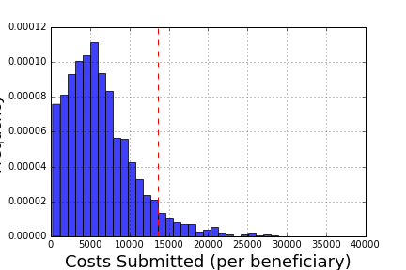
Distribution of Costs in Oncologists

